Slide 1


Paper-n-za-1eee Robotics process automation by guru aadithya s mohanapriya ap team : team 1

Slide 2

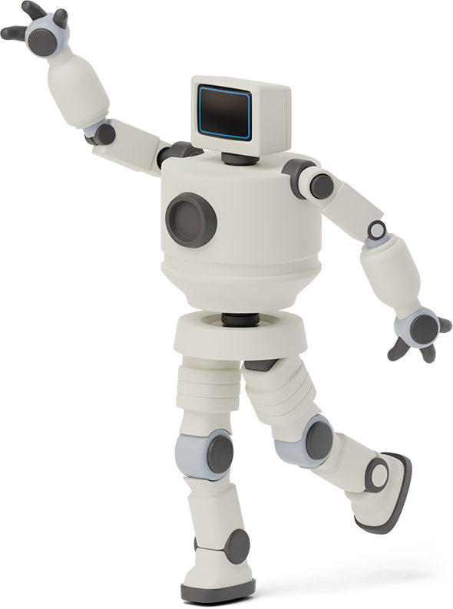

What is rpa ?
Robotic process automation (RPA) is a software technology that makes it easy to build, deploy, and manage software robots that emulate humans actions interacting with digital systems and software.

Slide 3








Steps involved in rpa :
Start
Read mail
Open excel attachment from excel
Enter data from excel in EPR data
Escalation
Analysis through employee
End.

Slide 4


Three major types:
RPA
Attended automation
Unattended automation
Hybrid RPA

Slide 5

Attended automation:
Attended RPA bots are like virtual assistants, helping an individual employee with their tasks to boost productivity. Legacy Attended Automation is confined to a single employee’s desktop

Slide 6

Examples of attended automation:
A popular example is in a customer service setting. A human team member can handle talking to a customer, while triggering the bot to pull customer information, for instance.

Slide 7
Unattended automation
Unattended RPA bots run automation that works on its own. The aim for many business processes is end-to-end automation, where bots are enabled to execute entire processes independently.

Slide 8


Examples of unattended automation
Unattended bots handle repetitive, frequent
and simple processes.
manual data entry,
email management,
repetitive admin,
monitoring, and so on.

Slide 9

Hybrid rpa
Hybrid automation encompasses RPA solutions that seamlessly integrate with the human workforce, allowing companies to leverage both human and robot workers for the tasks they are best suited to. ... This can make it difficult to apply automation solutions, which rely on highly structured processes to function.

Slide 10
Examples of hybrid rpa
a hybrid RPA bot using natural language processing could listen to a conversation between two people,
analyze that conversation in real time and then use that analysis to provide information that will help the attending human take the necessary next steps

Slide 11

Benefits of rpa
Boost Productivity Across the Board.
Improve Efficiency to Generate Savings.
Hit Accuracy Goals with Reliable Consistency.
Improve Business Data Security.
Seize Opportunities for Scale.
Produce Data for Important Analytics.
Create a Better Customer Service Experience

Slide 12

Thanks!
Any queries?

